Slide 1

Virtual Currency Influence on the Semiconductor Market
Eli Geva, CEO
Advanced Semiconductor Technology

Slide 2




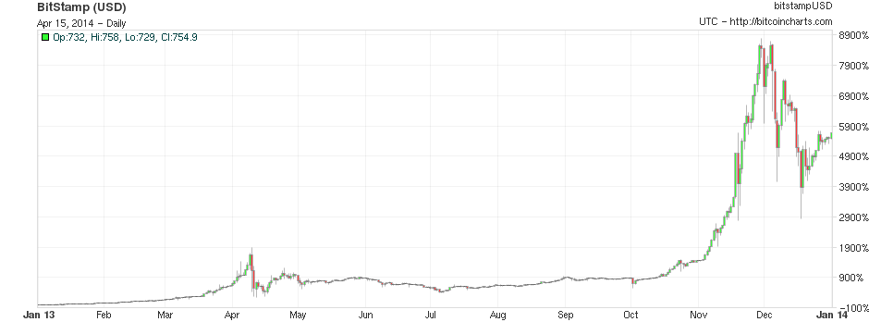
Virtual Currency Background
Bitcoin Price
56X
in 2013

Slide 3

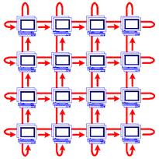
Virtual Currency Background
Phenomenon that was related to computer hackers only
In the past Virtual Currency users were using PCs and Laptops parallel
computing pools for Virtual Currency mining
Due to the increasing number of miners today, the Virtual Currency mining
has become very complex
When parallel computing didn’t yield a cost effective solution
HW solutions were started to be implemented such as GPUs & FPGAs

Slide 4
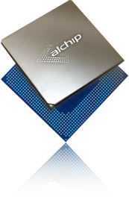
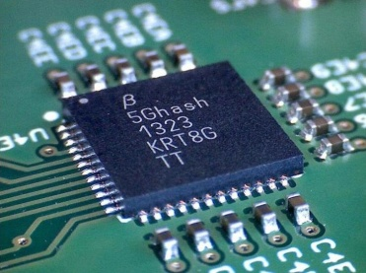
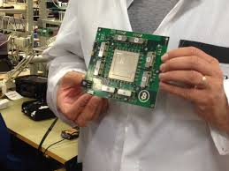
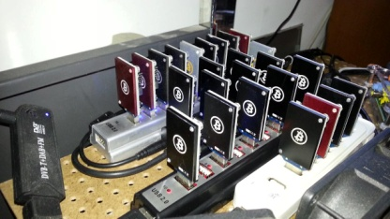
Virtual Currency Background (cont.)
When a simple/standard HW was not efficient enough, Complex High-End ASIC designs were the next target solution
During the 2nd half of 2013 there were around 10 ASIC projects (majority
in TSMC)
During the 1st half of 2014 there are multiple 28nm projects and at least
three 20nm projects
Virtual Currency ASIC business today is estimated in the range of $150M-
$200M per year, with overall business that can easily reach $1B / year!
In this presentation I’ll describes technical challenges and solutions in designing the first custom high end 28nm Bitcoin ASIC

Slide 5
First 28nm Bitcoin ASIC Challenges
Most ASIC requirements are usually targeting lowest cost, lowest power
consumption and fastest ASIC design possible
Virtual Currency ASIC requirements are rather unusual – the ASIC needs to
be as big as possible with the highest power consumption possible, speed is
not a major issue and cost is usually not an issue too…
The most important and main requirement for the Virtual Currency ASIC is
Time to Market which sometimes seems to be unrealistic to the “standard”
ASIC people
Virtual Currency mining performance is measured in Hash units and our first
Bitcoin ASIC requirements were: “we need the maximum Giga Hash possible
in a single chip and with a lead time of 4 months from design start to
production!

Slide 6
First 28nm Bitcoin ASIC Challenges
(cont.)
From a very quick analysis it was very clear that the limiting factor here is the
power consumption
Turnaround Time for the project was another major challenge
A high end technology was the only way to cope with the Power & Performance
The 4 month TAT seems to be impossible at that time for high-end ASIC
process node

Slide 7

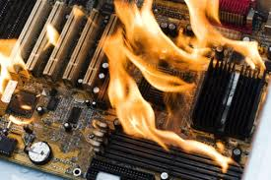

The Dilemmas
20nm or 28nm?
    A 28nm ASIC was selected
    Better TAT
    Lower risk
    20nm not mature enough (July 2013)
The Power dilemma
    Target power consumption: 300Watts per chip!!!
    A thorough thermal simulations had to be made
    High-end cooling system had to be considered
    A 55mm fcLBGA package with an appropriate cooling system was
    selected

Slide 8
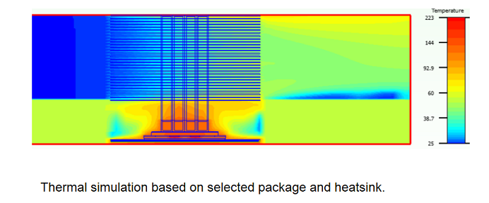
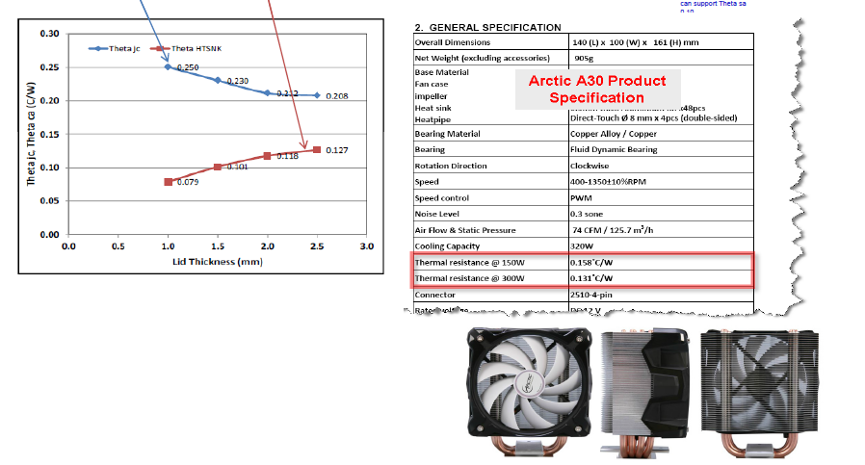
Bitcoin ASIC Thermal Case Study

Slide 9


Overcoming the Schedule Boundaries
The TAT requirement was 4 months from first RTL delivery!
Typical TAT for a 28nm ASIC in July was 6-8 months
    3-4 months only for production cycle
Thinking “out of the box”
in order to find ways to achieve the
required TAT
A risk management techniques to run the flow in parallel was used
Teams of a highly experienced ASIC engineers were used to minimize human
errors and to make sure first time successes
24/7 work was required

Slide 10
Overcoming the Schedule Boundaries (cont.)
Almost all aspects of the project and flow were done in parallel and with
several teams
Design was taped out while verification is still running
TSMC
  Deep acquaintance
  Physical presence
  High management support
Hand carry to/from assembly house
Risk Production Lots
>>>Prototype & first production lot in 3.5 months from initial RTL!!!<<<

Slide 11
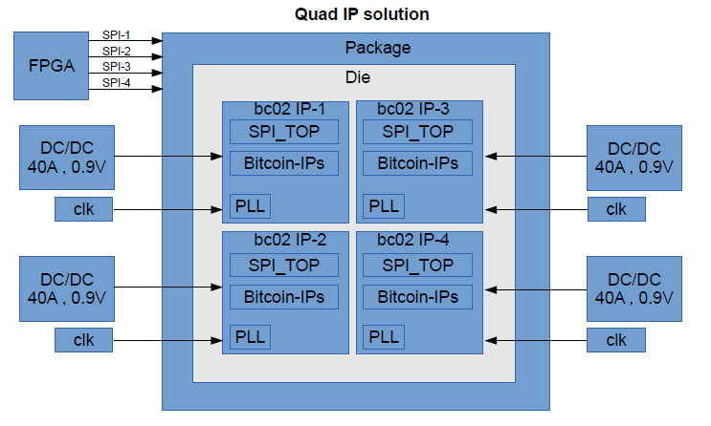
TAT Technical Aspects
Design split into 4 identical dies

Slide 12
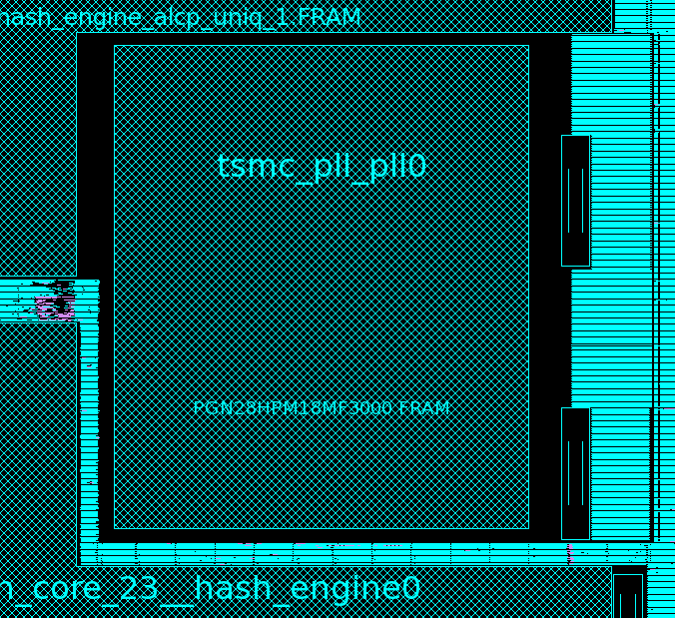
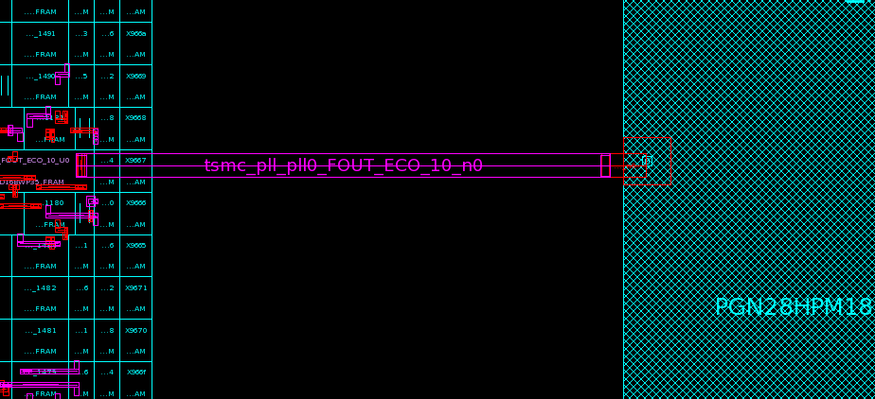
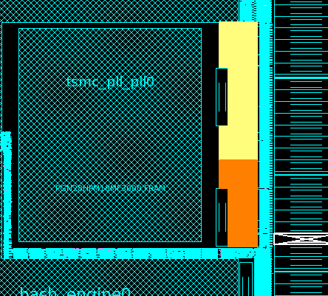
TAT Technical Aspects (cont.)
TSMC silicon proven PLL was selected keeping all Design Rules
10um
PCLAMP
10um keepout around PLL is preserved .
10um
PCLAMPC
OD18DCAP64BWP35: 1563
OD18DCAP32BWP35: 43
OD18DCAP16BWP35: 100
25.12pf > 20pf
DCAP64BWP35: 924
DCAP8BWP35 : 112
DCAP4BWP35 : 112
23.54pf > 20pf

Slide 13
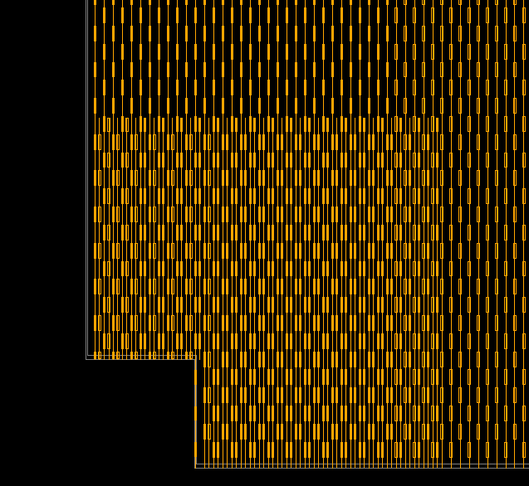
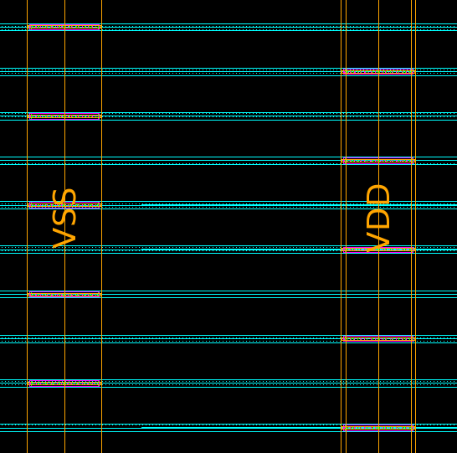
TAT Technical Aspects (cont.)
Power Mesh special care due to high power design

Slide 14
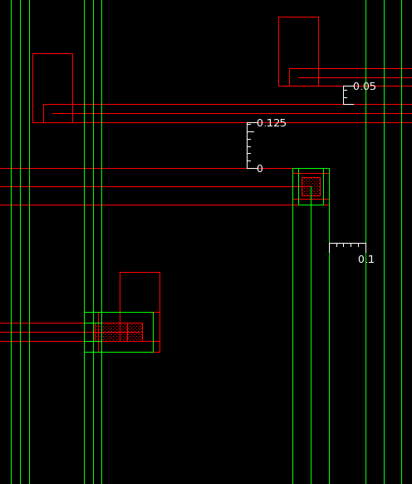
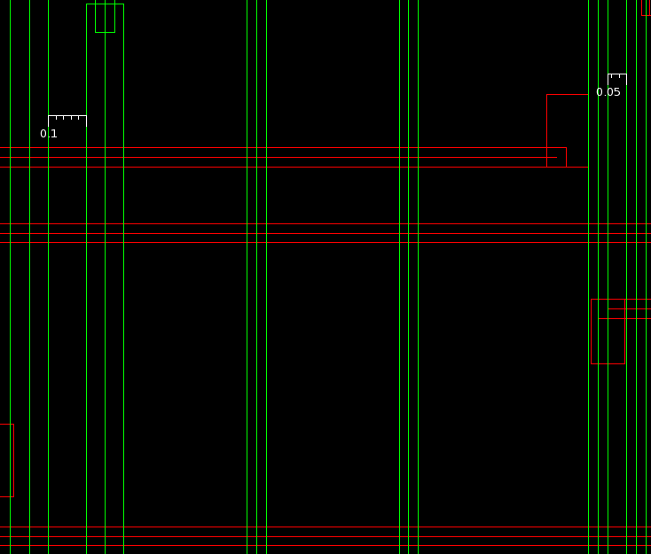
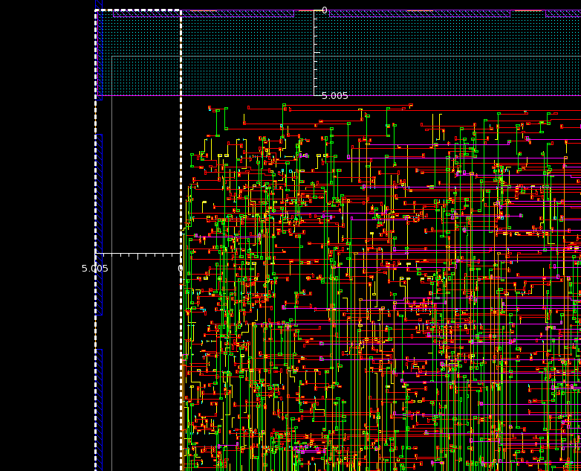
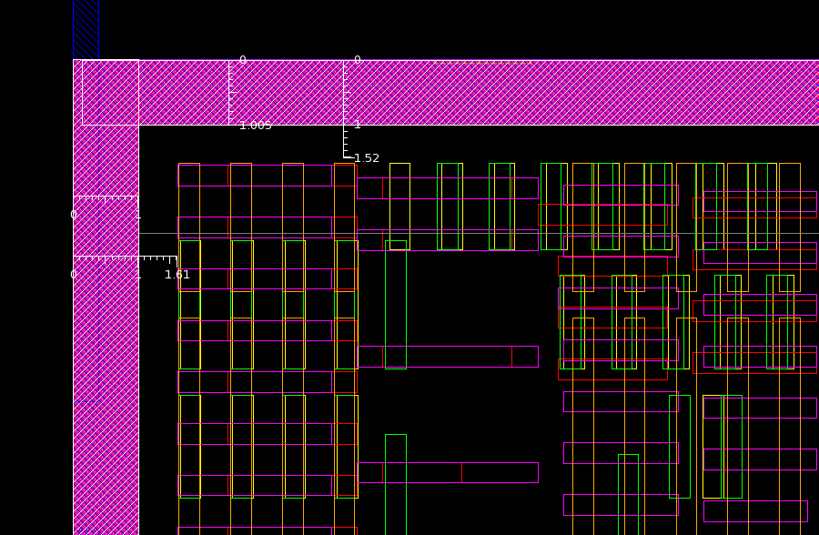
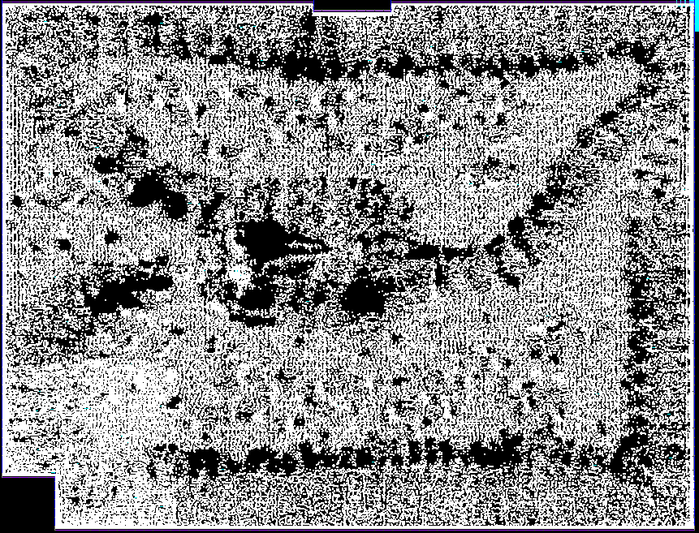
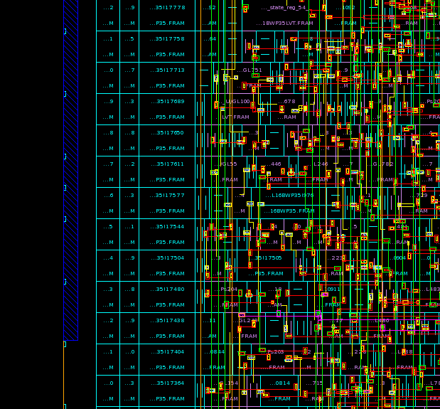
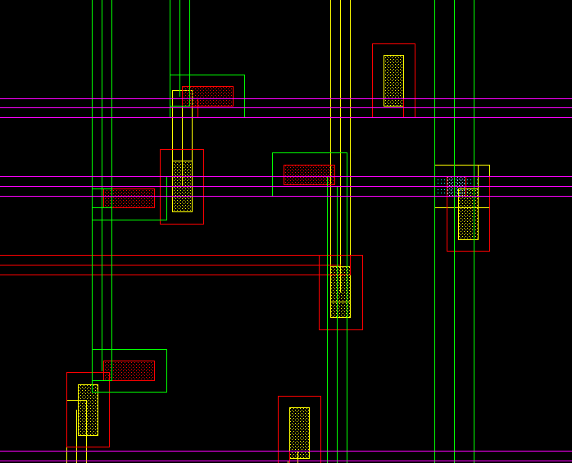
TAT Technical Aspects (cont.)
Not compromising on DRC & DFM
Routing guide
No signal routing around border in 5um width
Routing guide for dummy metal
DWDS rule for Clock net
GDCAP CELL
Route guide at boundary to avoid signal routing
DFM VIA insertion
5 um route guide for signal routing is preserved at the boundary of block.
5um

Slide 15
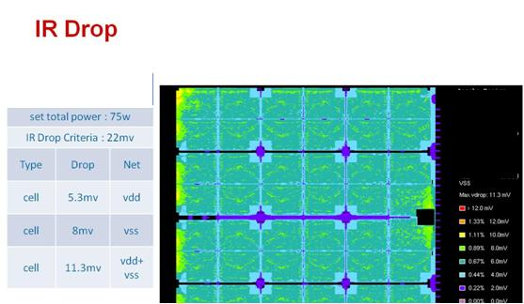
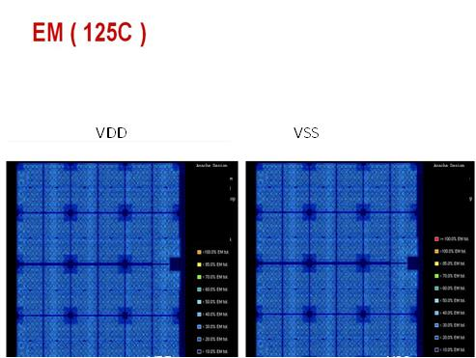
TAT Technical Aspects (cont.)
Special care to EM & IR Drop & Bump Current

Slide 16
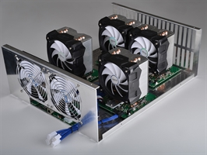
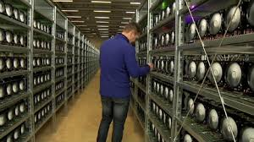
Summary
ASIC prototype worked first time and Bitcoin Mining Systems were ready 2
days after for shipment to customers
With “out of the box” thinking our customer supplied the first working 28nm
Bitcoin system in the market by far from all other Bitcoin mining companies
Recently we taped out a 20nm Bitcoin ASIC using the same techniques and managed even to improve!
The ASIC market is definitely influenced by the new
Virtual Currency trend

Slide 17
Thank you!
Questions?

