Slide 1
Jamil R. Mazzawi jamil@optima-da.com www.optima-da.com
Automotive-semiconductors Functional Safety
A practical chip design solution for functional safety in vehicles
Introduction to ISO-26262 challenges for IC’s

Slide 2
& Functional Safety
New challenges for design and verification engineers
What does it mean?
What are the requirements?
What are we protecting from?
How can we protect?
How can we measure our work, and improve it?
How can we get certified?

Slide 3
in one slide
5 Levels of Safety
Low-Risk
High-Risk
QM ASIL-A ASIL-B ASIL-C ASIL-D
*QM – Quality Management
**ASIL – Automotive Safety Integrity Level
Today considered very hard to achieve
QM – No safety requirements beyond basic quality
ASIL-A (least requirements)
ASIL-B
ASIL-C
ASIL-D (highest requirements)
Required Level Determined by
Exposure (probability)
Severity (potential harm)
Controllability (driver ability to avoid)

Slide 4
ISO-26262 challenges
Hard to get to ASIL-C and ASIL-D
Immense amount of fault-simulations needed
Current EDA tools running out of steam
No clear methodologies
Notes:
Hard to get to ASIL-C and ASIL-D
Using today’s tools, ASIL-D is considered very hard to achieve
Especially on big and complex chips
And specially when involving a multi-threaded complex CPU
The challenges are:
No clear methodology or automated tool for measuring and reducing soft-error FIT rate
No methodology at all for creating ASIL-D multi-threaded CPU’s
Each of the existing Safety-Mechanism methodologies for permanent-fault detection has weakness
Immense amount of fault-simulations needed:
All the FuSa steps involve immense amount of fault simulations
The size of this computational task can reach hundreds and thousands of years of CPU time

Slide 5
ISO-26262 requirements for IC’s (intro)

Slide 6
3 types of safety concerns (faults):
Systemic faults
Failure due to errors in implementation (“bugs”)
This is the domain of functional validation
Random faults
Failure due to the environment impacting a specific chip
Transient (soft-error)
or permanent (hard-error)
Safety Of The Intended Functionality (SOTIF)
Absence of unreasonable risk of the intended functions
The Working Group have separated the SOTIF from a Part in ISO-262626 into a new standard.
Optima hosted SOTIF meeting in Nazareth Oct 2017
Our focus

Slide 7
Transient-faults (Soft-errors/SEU/SET): What are they?
Bit-flips caused mostly by cosmic-rays
(radiation coming from the Sun)

Slide 8
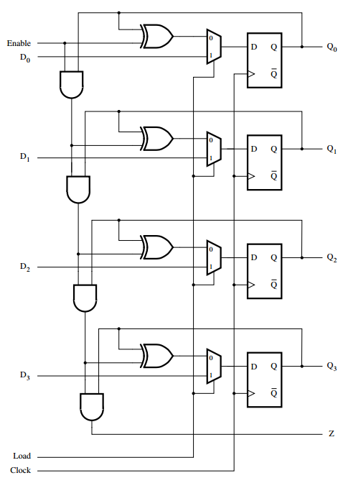
Transient-faults (Soft-errors/SEU/SET)
Where do they hit?
Memory bits:
Single or multiple bits
Gates:
Combinatorial logic
SET – Single-Event-Transient
Protecting against them
Flip-flops:
Bit-flip in a single flop
Memory:
ECC and bit dealignment
Gates: Low-probability,
not considered an issue by most experts
Flops:
Next slides
In FPGA: Also on configuration memory

Slide 9
Existing solutions and challenges Transient faults

Slide 10
Protecting against Transient-faults at the flops:
Selective flip-flop hardening
(cost: 1-5% more silicon)
Hardening all flops
(cost: 30% more silicon)
Unit-level Lockstep mechanism
(cost: 70% more silicon)
Design/RTL level mechanisms: Parity, encoding etc.
Silicon level: Using Rad-Hard or OLD nodes (180 nm...)

Slide 11
Selective hardening process:
Measure derated-FIT rate
Perform hardening on selected flops
Calculate post-hardening FIT rate
Decide is hardening needed?
A B C D
Does your derated-FIT rate meet your requirements?
Hardening means: replace the flop with hardened flop, with lower or close-to-0 FIT rate
Many project have 2 or more kinds of flops in their library: regular flop, hardened-flop, extra-hardened-flop
In most cases, hardening less than 5% of the flops will lower the FIT to close to 0
Hence meeting ASIL-D requirements with minimal silicon cost
Optima-SE performs this step
10,000 to 100,000 times faster than regular RTL simulators

Slide 12
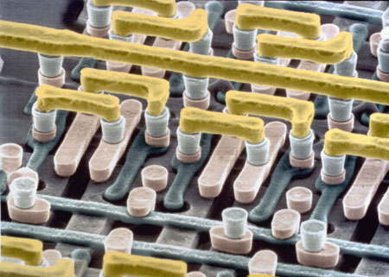
Permanent-faults or Hard-errors
What are they?
Permanent damage to a transistor
Fault models:
Stuck-at-0
Stuck-at-1
Bridging-Fault
Etc.

Slide 13
Hard-errors: ISO-26262 requirement (simplified)
Chip/IP needs to have “Safety Mechanisms” (SM)
The SM needs to detect HE’s
Detection needs to happen while the chip is working (on-the-fly)
Detection needs to be within the budgeted time interval
(for example 0.25ms to 100ms) from the time they happen
SM needs to meet Coverage requirement
The SM need to be able to detect no less than N% of the possible faults
Different ASIL levels have different N
For example: ASIL-D: N=99%

Slide 14
Existing solutions and challenges Permanent faults

Slide 15
Permanent-faults Safety Mechanisms:
Logic-BIST
STL – Software Test Library
Lockstep – unit level
Many other methodologies…

Slide 16
Lockstep methodology: (simplified)
Unit Inputs
Cache-Unit
(master)
Phase shift flop
Unit outputs
Phase shift flop
Cache-Unit
(shadow)
Compare outputs
Fault_detected

Slide 17
Lockstep methodology
Does not always achieve “99%” coverage
This was proven on number of designed examined by Optima
Are you duplicating internal memories or not?
Comparing internal memories I/O?
Important to “verify” the Lock-step mechanism for
Correctness
Measure detection coverage using fault-simulations
Using regular simulators: can be 100’s of years computational task

Slide 18
STL – Software test library
A Software that run on the chip/IP/unit (usually only for CPUs)
Test the unit for stuck-at hard errors
Usually it is:
Can not achieve high coverage
It is labor intensive to improve the coverage
Advantage: Low silicon cost

Slide 19
Permenant-faults: Measuring SM Coverage
Measuring and improving SM coverage is needed:
For all SM methodologies (STL, Lockstep, etc…)
To make sure we meet our ASIL targets
To prove to our customers and auditors
Need to perform fault-simulation on all gates
Measure if the SM can detect this fault or not
Run all needed fault models
Stuck-at-0
Stuck-at-1
Bridging-fault
Tristate-fault
Etc.
Need to be done on gate-level
The compute task is immense:
Number of gates X 2 X time-per-fault-gl-simulation
100M gates * 2 faults * 2 min = 400 M minutes = 761 years

Slide 20
Permanent-faults: Measuring SM Coverage
Needed for all type of SM’s
To meet ASIL target
To prove to our customers and auditors
Need to perform fault-simulation on all gates
Done on gate-level
Run on multiple fault models
Stuck-at-0, Stuck-at-1
Bridging-fault
Etc.
The compute task is immense:
Number of gates * 2 * time-per-fault-sim
Multiple fault simulations per gate
100M gates * 2 faults * 2 min = 400 M minutes = 761 years

Slide 21
Development Process: for STL/Lockstep
Write STL or impl. Lockstep
Examine Coverage Results:
Meeting req?
Examine Coverage Booster outputs
Run Optima-HE
Fine-tune STL based on CB
iteration
A B C D E
No
Yes
Done
Optima-HE does this step over 1,000 times faster than our competitor
Reducing this step from weeks to hours
Note:
The same process is used for all types of SM’s for HE detection
STL has the most iterations...

Slide 22
Optima Automotive Safety Platform for ISO-26262 ASIL-D
Optima-SE™
^{Complete Soft Error Solution}
Soft Error simulation
Optima-HE™
^{Hard Error Coverage}
^{measurement & Boosting}
Hard Error safety mechanism coverage
Selective flip flop hardening
Reduce your FIT rate to ASIL-D level with low silicon cost
Coverage Booster
Automate the converge raising effort
Integration with ANSYS
Medini Safety platform
Functional Safety services
Other offering
Both Pre-silicon and Post-Silicon Applications
More tools and details at our booth or under NDA
All based on Optima’s Fault Injection Engine
Over 100,000 faster than RTL simulators
Over 1,000 faster than all other fault-simulators

Slide 23
Automotive-semiconductors Functional Automation
See you at
our booth!!!
the sweetest giveaway at ChipEx ->
www.optima-da.com
info@optima-da.com

