Slide 1
Functional Safety Solutions for Automotive
FMEDA automation and predictable ISO 26262 compliance
Vladislav Palfy
vladislav.palfy@onespin.com

Slide 2
IC Integrity
Functionally correct, safe, secure, and trusted SoCs/ASICs/FPGAs
Functional
Correctness
Trust and
Security
Safety
OneSpin provides certified IC Integrity Verification Solutions to develop functionally correct, safe, secure, and trusted integrated circuits.
IC Integrity
SoC/ASIC/FPGA Verification Flow
Design
Integration
Implementation

Slide 3
IC Integrity
Functionally correct, safe, secure, and trusted SoCs/ASICs/FPGAs
Functional
Correctness
Trust and
Security
Safety
OneSpin provides certified IC Integrity Verification Solutions to develop functionally correct, safe, secure, and trusted integrated circuits.
IC Integrity
SoC/ASIC/FPGA Verification Flow
Design
Integration
Implementation

Slide 4
Introduction to Functional Safety
The objective of functional safety:
Freedom from unacceptable risk of physical injury or of damage to the health of people either directly or indirectly
Functional Safety Risks
Risk drivers
Risk management through functional safety standards
Systematic Failures
Design faults
Tool faults
Random Failures
Permanent faults
Transient faults
Continuous increase in flow and tool complexity
Continuous increase in functionality
Increasing density of the design process node
Decreasing energy levels
Minimize systematic failures
Safeguard against random failures

Slide 5
High-Level Safety Flow
Minimize systematic failures
Safeguard against random failures
Functional Requirements Safety Requirements/Goals
HW Specification
HW Safety
Specification
HW Safety Analysis
Design Implementation
Safety Mechanism Implementation
Diagnostic Coverage
Determination
Functional Verification
Quantification of Verification
Verification of the Safety Mechanism
Evaluation of
Hardware Metrics
Covered by OneSpin

Slide 6
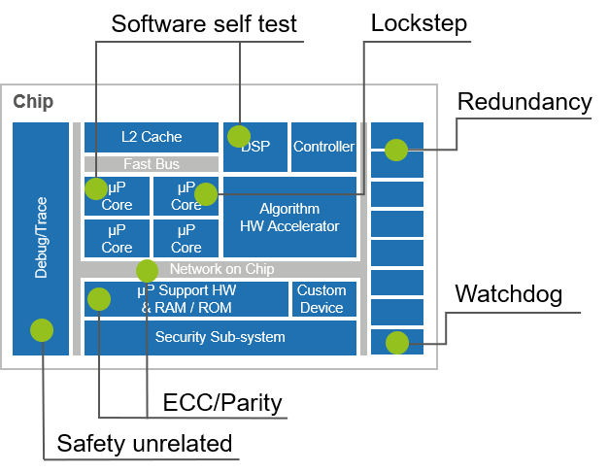
OneSpin FMEDA Methodology Overview
ISO 26262 compliant flow
Safety Goals
HW Safety Analysis
ISO 26262 work products
in regards to random hardware failures
Diagnostic Coverage
Determination
Evaluation of
Hardware Metrics

Slide 7
Top Down and Bottom Up Safety Analysis
Deductive
Top Down
Inductive
Bottom Up
Safety Goal:
No unintended inflation of airbag, ASIL C/D
Failure Mode:
Wrong value from CPU
Failure:
4 + 4 = 4
Fault:
StuckAt 0 on bit reg[2]

Slide 8
Hardware Safety Analysis
Failure Mode Contribution Analysis (FCA) App
Safety Engineer analyzes
the failure modes causing
safety goal violations.
But which failure mode can be caused by which fault?
Hardware Design Safety Goals
Safety Goal
Failure Mode
Fault
HW Safety Analysis
And, which Safety Mechanisms are in place?
Diagnostic Coverage
Determination
Evaluation of
Hardware Metrics
Notes:
We ran this at over 2 billion transistors. Runs at SoC level. It’s a structural analysis.
Failure Mode is conversative

Slide 9
Hardware Safety Analysis
Failure Mode Contribution Analysis (FCA) App
Safety Engineer analyzes
the failure modes causing
safety goal violations.
But which failure mode can be caused by which fault?
Hardware Design Safety Goals
Safety Goal
Failure Mode
Fault
HW Safety Analysis
And, which Safety Mechanisms are in place?
Diagnostic Coverage
Determination
The FCA App runs a structural HW safety analysis by linking failures to faults (failure mode distribution). This is a deductive (top down) analysis validated by an automated inductive coherency check.
Evaluation of
Hardware Metrics
Notes:
We ran this at over 2 billion transistors. Runs at SoC level. It’s a structural analysis.
Failure Mode is conversative

Slide 10
Hardware Safety Analysis
Failure Mode Contribution Analysis (FCA) App
Safety Engineer analyzes
the failure modes causing
safety goal violations.
But which failure mode can be caused by which fault?
Hardware Design Safety Goals
Safety Goal
Failure Mode
Fault
HW Safety Analysis
And, which Safety Mechanisms are in place?
Diagnostic Coverage
Determination
The FCA App runs a structural HW safety analysis by linking failures to faults (failure mode distribution). This is a deductive (top down) analysis validated by an automated inductive coherency check.
Evaluation of
Hardware Metrics
Automated failure mode distribution reduces engineering effort.
Precise fault allocation minimizes/eliminates fault simulation.
Notes:
We ran this at over 2 billion transistors. Runs at SoC level. It’s a structural analysis.
Failure Mode is conversative

Slide 11
FCA Example: FIFO with ECC Protection
FCA results with diagnostic coverage estimation
data
rd_data
encode
FFs
decode
rd_error
rd_corrected
clk/rst
read
control
full
write
empty
Sub part | Area / Failure Mode Distribution | State Count | Fault Count | Diagnostic Coverage
storage | 151.2 | 72 | 1024 | 100%
control | 32.3 | 8 | 434 | 0%
clk/rst-tree | 0.7 | 0 | 28 | 0%
active-encode | 4.4 | 0 | 52 | ?%
active-decode | 9.55 | 0 | 126 | ?%
passive-decode | 10.73 | 0 | 130 | ?%

Slide 12
Hardware Safety Analysis Overview
ISO 26262 compliant flow
Automated design analysis a key factor for efficient analysis of random hardware failures
Safety Goals
HW Safety Analysis
ISO 26262 work products
in regards to random hardware failures
Diagnostic Coverage
Determination
Evaluation of
Hardware Metrics

Slide 13
Diagnostic Coverage Determination
Fault Propagation and Detection Analysis (FPA/FDA) Apps
How many faults are covered by safety mechanisms?
How many of the faults in the safety-related hardware element cannot violate the safety goal (Safe Fault Fraction)?
Hardware Design Safety Goals
HW Safety Analysis
Diagnostic Coverage
Determination
Evaluation of
Hardware Metrics

Slide 14
Diagnostic Coverage Determination
Fault Propagation and Detection Analysis (FPA/FDA) Apps
How many faults are covered by safety mechanisms?
How many of the faults in the safety related hardware element cannot violate the safety goal (Safe Fault Fraction)?
Hardware Design Safety Goals
Expert judgment of diagnostic coverage leverages precise FCA fault allocation.
When expert judgment cannot be applied the FDA App determines the diagnostic coverage or fault simulation is applied.
FPA App automates safe fault extraction based on assumptions of use.
HW Safety Analysis
Diagnostic Coverage
Determination
Evaluation of
Hardware Metrics

Slide 15
Diagnostic Coverage Determination
Fault Propagation and Detection Analysis (FPA/FDA) Apps
How many faults are covered by safety mechanisms?
How many of the faults in the safety related hardware element cannot violate the safety goal (Safe Fault Fraction)?
Hardware Design Safety Goals
Expert judgment of diagnostic coverage leverages precise FCA fault allocation.
When expert judgment cannot be applied the FDA App determines the diagnostic coverage or fault simulation is applied.
FPA App automates safe fault extraction based on assumptions of use.
HW Safety Analysis
Diagnostic Coverage
Determination
Safe fault extraction eliminates manual fault analysis.
Automated diagnostic coverage determination does not require a testbench and can replace fault simulation.
Evaluation of
Hardware Metrics

Slide 16
Fault Detection Analysis App Flow
Fault
Diagnostic coverage without simulation
Inject Faults in SMs
Detected (multipoint)
Fault can propagate to at least one observation
point and alarm is asserted
Non-detected (residual)
Fault can propagate to at least one observation
point and alarm is NOT asserted
Non-propagated (safe or latent)
Fault does not propagate to observation
points
Inputs
decode
encode
FFs
Observation
Points
control
Diagnostic
Points
FDA
Fault Classification
Report/DB
RTL / Netlist
Fault List
Input
Constraints

Slide 17
FDA Example: FIFO with ECC Protection
Measuring diagnostic coverage for each sub-part
data
rd_data
encode
FFs
decode
rd_error
rd_corrected
clk/rst
read
control
full
write
empty
Sub part | Area / Failure Mode Distribution | State Count | Fault Count | Diagnostic Coverage
mem-data | 151.2 | 72 | 1024 | 100%
control | 32.3 | 8 | 434 | 0%
clk/rst-tree | 0.7 | 0 | 28 | 0%
active-encode | 4.4 | 0 | 52 | 100%
active-decode | 9.55 | 0 | 126 | 75%
passive-decode | 10.73 | 0 | 130 | 24%

Slide 18
OneSpin FMEDA Methodology Overview
ISO 26262 compliant flow
Automated design analysis a key factor for efficient analysis of random hardware failures
Safety Goals
HW Safety Analysis
ISO 26262 work products
in regards to random hardware failures
Diagnostic Coverage
Determination
Evaluation of
Hardware Metrics

Slide 19
Evaluation of Hardware Metrics
Hardware Metric Computation (HMC) App
Which metrics must be produced to achieve ISO 26262 compliance?
Single-Point Fault Metric (SPFM)
Reflects the robustness of the component with respect to safety goal violation by individual faults
Latent Fault Metric (LFM)
Reflects the robustness of the component with respect to safety goal violation by multiple-point faults (faults in safety mechanism and function)
Probabilistic Metric for Random Hardware Failures (PMHF)
Residual risk of the safety architecture. Measured by Failure in Time (FIT)
Hardware Design Safety Goals
HW Safety Analysis
Diagnostic Coverage
Determination
Evaluation of
Hardware Metrics

Slide 20
Evaluation of Hardware Metrics
Hardware Metric Computation (HMC) App
Which metrics must be produced to achieve ISO 26262 compliance?
Single Point Fault Metric (SPFM)
Reflects the robustness of the component with respect to safety goal violation by individual faults
Latent Fault Metric (LFM)
Reflects the robustness of the component with respect to safety goal violation by multiple-point faults (faults in safety mechanism and function)
Probabilistic Metric for Random Hardware Failures (PMHF)
Residual risk of the safety architecture. Measured by Failure in Time (FIT)
Hardware Design Safety Goals
HW Safety Analysis
Diagnostic Coverage
Determination
The HMC App enables full chip, multi-user, early estimation of the hardware metrics and compliance when data from FCA and the Diagnostic Coverage Determination becomes available.
Evaluation of
Hardware Metrics

Slide 21
Evaluation of Hardware Metrics
Hardware Metric Computation (HMC) App
Which metrics must be produced to achieve ISO 26262 compliance?
Single Point Fault Metric (SPFM)
Reflects the robustness of the component with respect to safety goal violation by individual faults
Latent Fault Metric (LFM)
Reflects the robustness of the component with respect to safety goal violation by multiple-point faults (faults in safety mechanism and function)
Probabilistic Metric for Random Hardware Failures (PMHF)
Residual risk of the safety architecture. Measured by Failure in Time (FIT)
Hardware Design Safety Goals
HW Safety Analysis
Diagnostic Coverage
Determination
The HMC App enables full chip, multi-user, early estimation of the hardware metrics and compliance when data from FCA and the Diagnostic Coverage Determination becomes available.
Evaluation of
Hardware Metrics
No expert level ISO 26262 knowledge required and avoids spreadsheet madness.

Slide 22
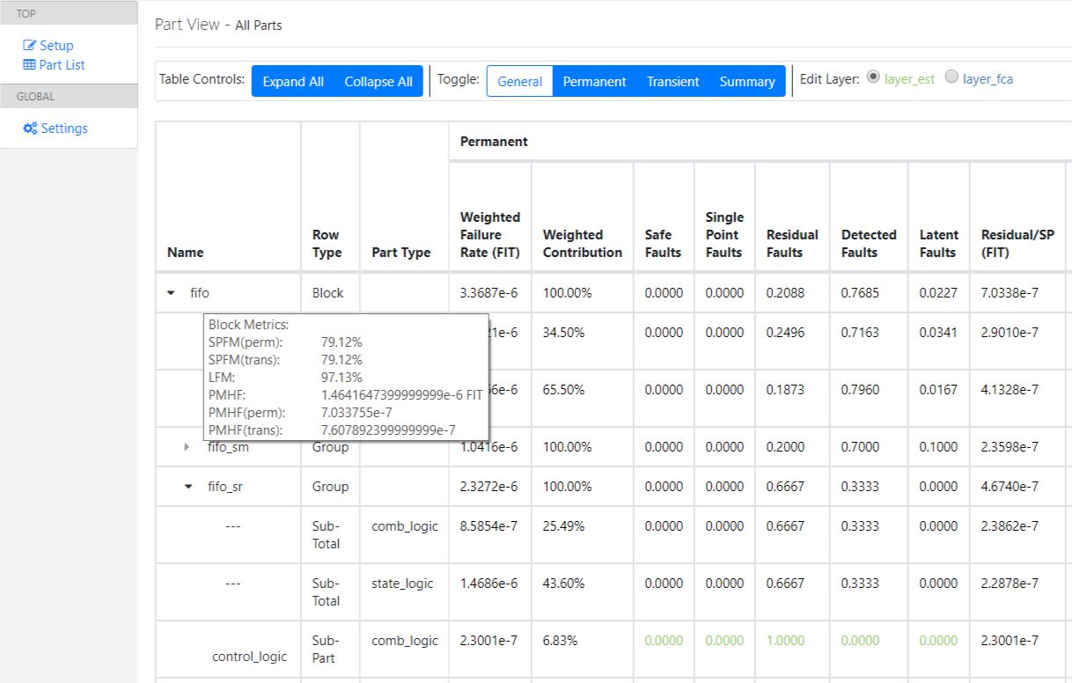
Hardware Metric Calculation Example
Web technology enables different use model
Calculates hardware metrics
SPFM
LFM
PMHF
Supports layering
Estimation layer
FCA layer
Client/Server architecture
Multi-user
Single DB

Slide 23
OneSpin FMEDA Methodology Summary
ISO 26262 compliant flow
Safety Goals
FMEDA
HW Safety Analysis
ISO 26262 work products
in regards to random hardware failures
Diagnostic Coverage
Determination
Evaluation of
Hardware Metrics
Automated FMEDA flow for predictable ISO 26262 compliance
Reduce fault simulation
Reduce/eliminate manual analysis
Implement a repeatable, reusable and robust flow

Slide 24
Thank You!

